Slide 1
Lung Cancer Screening Patient Level Data Collection
NHS England Lung Cancer Screening Team
21st May 2026
Notes:
Standard title slide

Slide 2
House-keeping
We’re going to record the Q&A so that we can share it after the session.
You’re welcome to add questions in the chat as we go and we’ll come back to them.
Notes:
Put the recording on!! Please be aware if you ask questions during the recording you are being recorded!

Slide 3
Agenda
LCS collection recap and IG
Data set development updates
National Data Submission Portal
Supporting analytical reporting requirements
Provider support
Next steps
Q&A

Slide 4
Lung Cancer Screening patient level collection- recap

Slide 5
LCS data collection recap
  Providers should begin to collect data locally from the start of July 2026, according to the Lung Cancer Screening specification
  National data submission of this data will start from August 2026. Submission in August 2026 should contain activity data which happened during the month of July.
  Allowances for sites not able to submit sooner; all providers need to be able to submit from April 2027. Regardless of when providers begin to submit data nationally, data must still be collected locally from July 2026 and this data submitted retrospectively
  Mandatory submission to the current aggregate collection will continue for all sites until April 2027
  Granularity of submissions is at ‘site’ level; work has been ongoing with Cancer Alliances to define ‘sites’
  All sites and providers will need a valid ODS code to be able to make a successful submission and to request permission to the submission portal
  NHS England will be responsible for the creation and maintenance of ODS codes for LCS sites
  We are also exploring options for historical data submissions but are not asking providers to prepare for this yet, and will not expect this from August

Slide 6
LCS Information Governance
Resources available
  IG Q&A session recording and slides, NHSE DPIA, LCS controller table
  We will be holding further IG drop-in sessions in future (invites to be sent soon)
  NHS Vaccincation and Screening Directions 2026 live
  Change since the previous version of the DPIA: it will be updated to include historical data submissions. Please bear this in mind when reviewing local agreements and how they need to be amended.
DPN/ISNs
  We are now in the final stages of IG sign off and expect to publish the Data Provision Notice (DPN) in June
  New data collections, including LCS, will no longer be supported by the provision of an Information Standards Notice (ISN)
  Data collections are different to information standards and published under a separate legal basis, contained in the Act
  Information standards are cross cutting, providing the fundamental basis for system change and interoperability, such as Data Security and Protection Toolkit
  Data collections are accompanied by the publication of a Data Provision Notice which provides an explanation of the legal basis for organisations to provide specific data sets to NHS England

Slide 7
Data set development updates

Slide 8
Data set development updates
The following material is available at Lung Cancer Screening Data Set: Implementation tools and guidance - NHS England Digital:
  Enhanced Technical Output Specification (ETOS) v1.0.8
  ETOS walkthrough recording
  User Guidance
  Data Model
  XML schema – Details are on the LCSDS submissions webpage and on the following slides
State of Readiness Questionnaire – Proposing to publish on Friday 22 May 2026, closing Monday 15 June 2026
Scenarios
FAQs

Slide 9
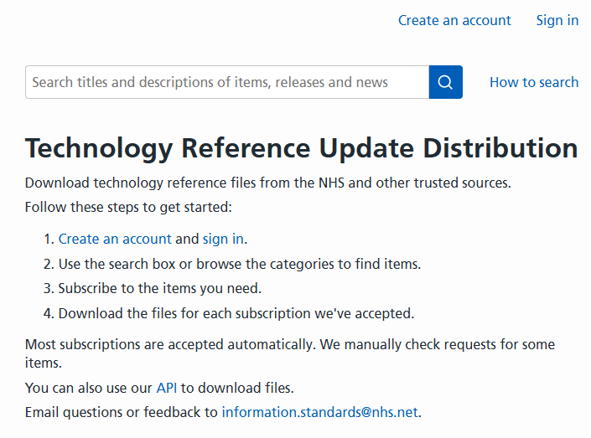
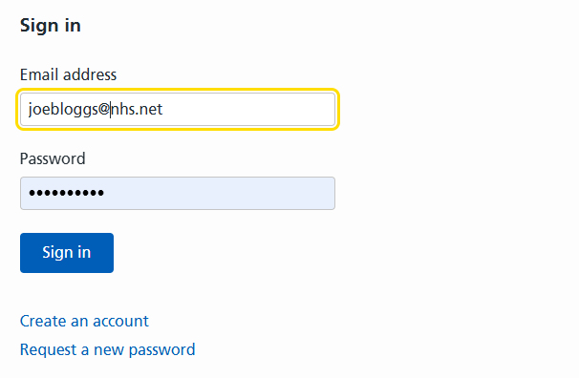
Data set development updates
LCSDS XML Schema
To enable you to make your submissions, we have created an XML Schema.
To access a copy of the XML Schema, you need to create a new account on the Technology Reference Update Distribution webpages (TRUD).
Once you have created a new account, you will be able to login, subscribe and download a copy of the XML Schema for LCSDS v1.0 (please refer to the screenshots within these slides).

Slide 10
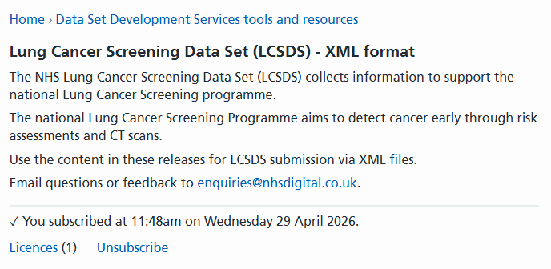
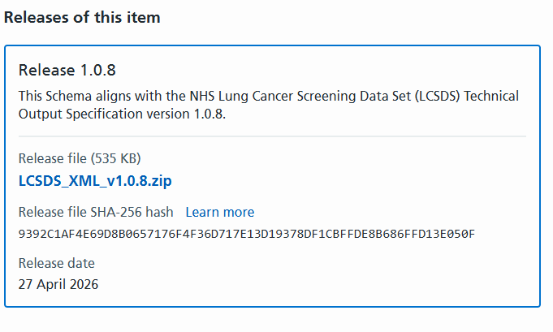
Data set development updates
LCSDS XML Schema
Once you have created a login, click on ‘Categories/Data Set Development Services Tools and Resources’.
You need to subscribe to then see the latest release. You will then be able to download the sample XML Schema which is held within a zip file (please refer to the screenshots within these slides).

Slide 11
Data set development updates
State of Readiness Questionnaire
We have created an online State of Readiness Questionnaire for the Lung Cancer Screening Data Set (LCSDS) v1.0.
We anticipate publishing this on Friday 22 May 2026, and it will be open for approximately 3 weeks, closing on Monday 15 June 2026.
Prior to implementation of the data set in July 2026, we are now looking for feedback on your 'readiness' to make submissions.
We welcome your feedback on the questions we have included within this questionnaire, your responses will allow NHS England to assess progress in conforming to the LCSDS v1.0.
The following slides include some screenshots of how the questionnaire may appear when you receive the link once it is published.

Slide 12
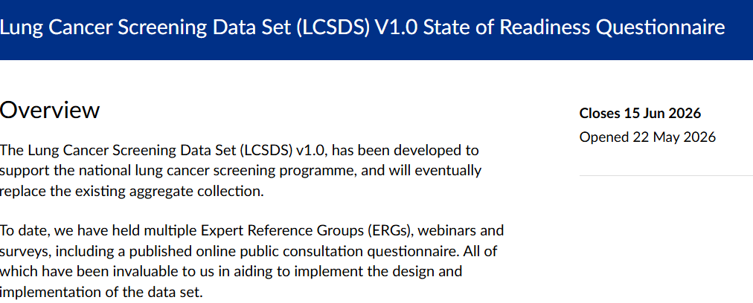
Data set development updates
State of Readiness Questionnaire

Slide 13
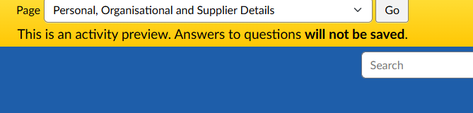
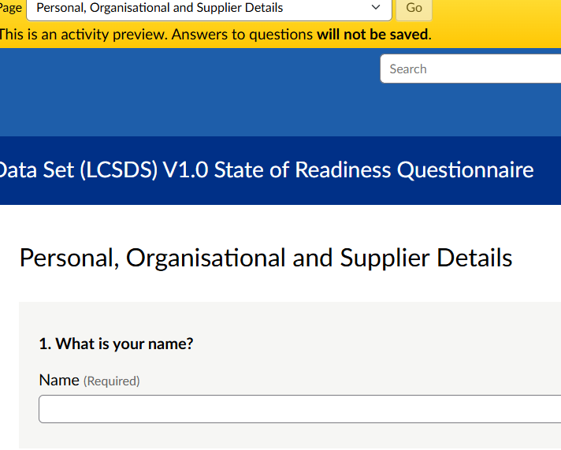
Data set development updates
State of Readiness Questionnaire
You can navigate through each page of the questionnaire using the 'page' box at the top of the screen, using the dropdown box and hitting 'Go'
You will then be required to complete the questions on each page

Slide 14
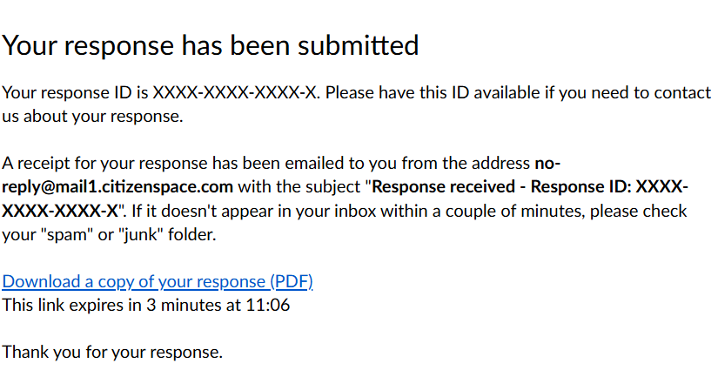
Data set development updates
State of Readiness Questionnaire
Some of the questions are required which means you will not be able to progress to the next page without adding some information.
There is a 'Save and come back later' option within the questionnaire. This enables you to stop part way through, save what you have completed and come back to where you left it at a later time. You must ensure that you have entered your e-mail address correctly, as you will be sent a link to the e-mail address that you give, which will take you back to your partially completed questionnaire.
Once you have completed the questionnaire, you will receive the following message.
If you have any issues regarding the questionnaire, please contact dataset.development@nhs.net

Slide 15
National Data Submission Portal (NDSP)

Slide 16
National Data Submission Portal
NDSP recap - submission portal for LCS
Getting started – CIS2 accounts
Devolved permission model
Submission model recap and timetable
Cancer Alliance submission dashboard
Getting involved

Slide 17
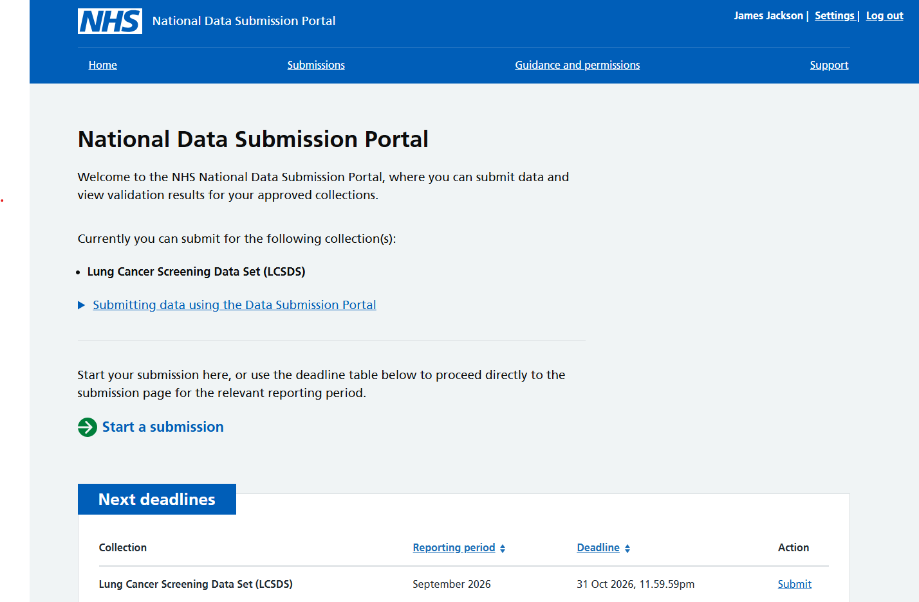
National Data Submission Portal (NDSP) Recap
A single data submission portal that sits on the National Data Integration Tenant (NDIT) platform
Consistent experience for data submitters
Choice of submission routes
  File upload
  API
  FDP Local Tenant /Healthcare Decision Suite
Consistent data validation
Notes:
NDSP will sit on NDIT
A single data submission portal
Manage everything in one place
Ambition is to eventually consolidate 24+ legacy portals
Choice of submission routes to reduce burden
API, file transfer, file upload, webform and FDP local tenant flows
Consistent data validation
Data Validation Engine (DVE) using shared rules
Collection management
Management information, collection windows, permissions

Slide 18
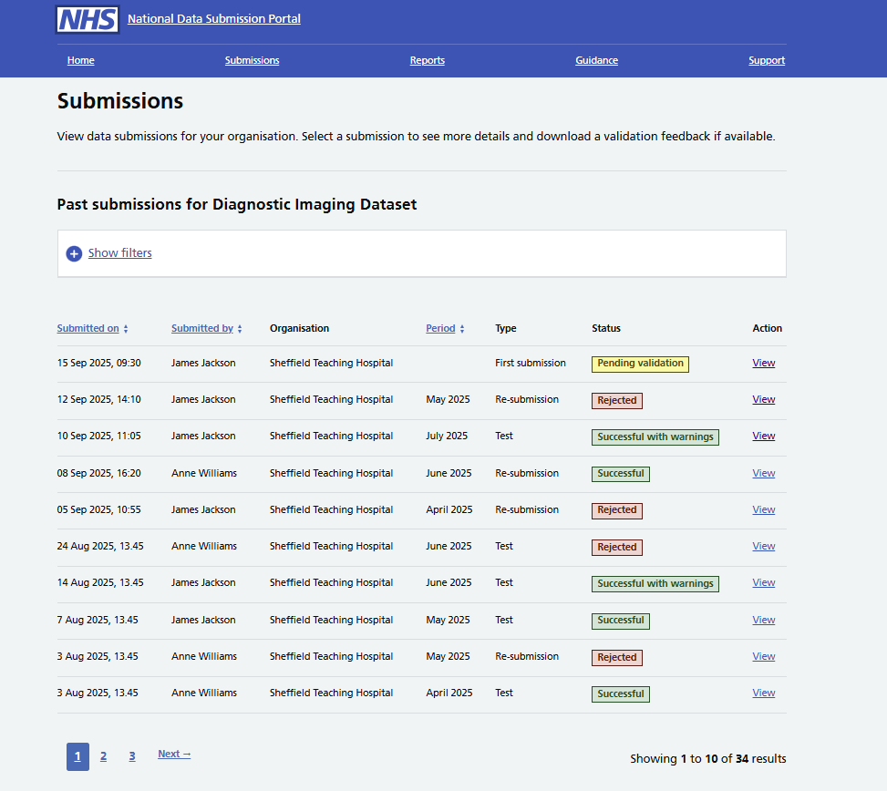
What does the NDSP do?
Enables secure data submissions to NHS England
Provides data validation feedback
Automated reminders:
  Submission window opens
  5 days before deadline
  1 day before deadline
Allows you to view your submissions history
Notes:
NDSP will sit on NDIT
A single data submission portal
Manage everything in one place
Ambition is to eventually consolidate 24+ legacy portals
Choice of submission routes to reduce burden
API, file transfer, file upload, webform and FDP local tenant flows
Consistent data validation
Data Validation Engine (DVE) using shared rules
Collection management
Management information, collection windows, permissions

Slide 19

Setting up a CIS account if you don’t have one
NDSP uses CIS2 authentication.
Care Identity Service (CIS) is a service covering identity management and access management for services accessed by health and social care workers. CIS2 authentication is part of Care Identity Service (CIS).
To access services with CIS2, most users sign in using an NHS smartcard.
Smartcards are like chip and pin bank cards and are used in conjunction with a passcode via a smartcard reader.
However, CIS2 offers lots of other different two factor authentication methods.
To use them, you still need a CIS Account first.
Here a list of non-smartcard authenticators:
  Microsoft Authenticator
  Passkey
  iPad
  Windows Hello
  Security key, including YubiKey

Slide 20
Setting up a CIS account if you don’t have one
Follow these steps if you need a CIS account (aka CIS Profile).
Contact your Registration Authority: reach out to your Registration Authority (RA) or local CIS sponsor to discuss the registration process.
Submit your application: follow the application process provided by your Registration Authority and complete your identity verification.
Choose an Authenticator: select an authenticator method (smartcard, authenticator app, or security key) that suits your needs.
Each NHS smartcard/CIS Account typically have role-based access codes (RBAC) assigned. NDSP doesn’t need any code associated to your account.

Slide 21
How to find a Registration Authority
To find your Registration Authority you can:
Ask a colleague that has access to Care Identity Management
Contact your local IT helpdesk
Check if the primary care service provider contact details page contains the details you need
Contact iamplatforms@nhs.net
If your organisation doesn’t have a Registration Authority contact our service desk: ssd.nationalservicedesk@nhs.net

Slide 22
Devolved permissions model
  All data submitters will also need permissions to access the National Data Submission Portal (NDSP), which will be the platform via which submissions can either be manually uploaded or system sent via an API (using an assigned API token).
  Some NHS Trusts may choose to submit data via their Healthcare Decision Suite (HDS); we will be approaching those Trusts who are currently ‘in delivery’ or ‘on-boarding’ phases with HDS.
  The National Data Submission Portal (NDSP) uses a partially devolved permissions model. This means some access is managed centrally by NHS England, while other access can be delegated to local administrators within provider organisations.
  By default, any permission requests must be approved first by one of the organisation’s Information Governance (IG) managers: a Caldicott Guardian, an Information Asset Owner (IAO) or a Senior Information Risk Owner (SIRO) (as named in the ODS portal). Following approval, the permission will be granted by NHS England.
  Your organisation will also have the option to set up local administrators – approved by an IG manager – who can grant and remove permissions for submitters.

Slide 23
Submission implementation- record level rejections
The Lung Cancer Screening collection uses a combination of rules when accepting data:
  When you upload a file into NDSP, your submission file will automatically be validated against the rules defined in the Lung Cancer Screening specification (the ETOS), checking each record’s content and structure.
  This validation will be performed at an individual record level. This means that records which pass all checks will be accepted, even if other records within the same file fail. This is known as record level validation rejections
    For example, if you submit a file for a given month which has 100 records in it, but five of the records have errors, rather than rejecting the entire file, we will just reject the five records and the 95 good records will be accepted
  You’ll be able to download an error report, which will detail any errors or warnings for the records you upload

Slide 24
Submission implementation- last good file
  During any given submission window, you can choose to submit as many files as you wish during the window, but NHSE will only use and process the ‘last good file’ received during that submission window
  If you wish to resubmit a file during a submission window you must resend the entirety of activity data for the specified month and not just the corrected records
  You may choose to submit again during the submission window because you:
      want to correct previous records which have failed validation checks
      have identified a new error with the submitted file
      need to include new information such as:
        updates to previous records submitted
        new records, i.e. additional screening activity within the submission window that wasn’t in your initial file submission

Slide 25
Submission timetable including resubmission profile
Activity month/ reporting period | Submission window opens | Submission window closes | Resubmissions which can be sent (see next page for e.g. screen shot
Jul-26 | 1 Aug-26 | 31 Aug-26 | N/A
Aug-26 | 1 Sep-26 | 30 Sep- 26 | July
Sep-26 | 1 Oct-26 | 31 Oct- 26 | July, August
Oct-26 | 1 Nov-26 | 30 Nov- 26 | July, August, September
Nov-26 | 1 Dec-26 | 31 Dec- 26 | July, August, September, October
Dec-26 | 1 Jan-27 | 31 Jan- 27 | July, August, September, October, November
Jan-27 | 1 Feb-27 | 28 Feb- 27 | July, August, September, October, November, December
Feb-27 | 1 Mar-27 | 31 Mar- 27 | July, August, September, October, November, December, January
Mar- 27 | 1 Apr- 27 | 30 Apr- 27 | July, August, September, October, November, December, January, February
Jul- 26 to Mar- 27 | 1 May-27 | 31 July | July, August, September, October, November, December, January, February, March

Slide 26
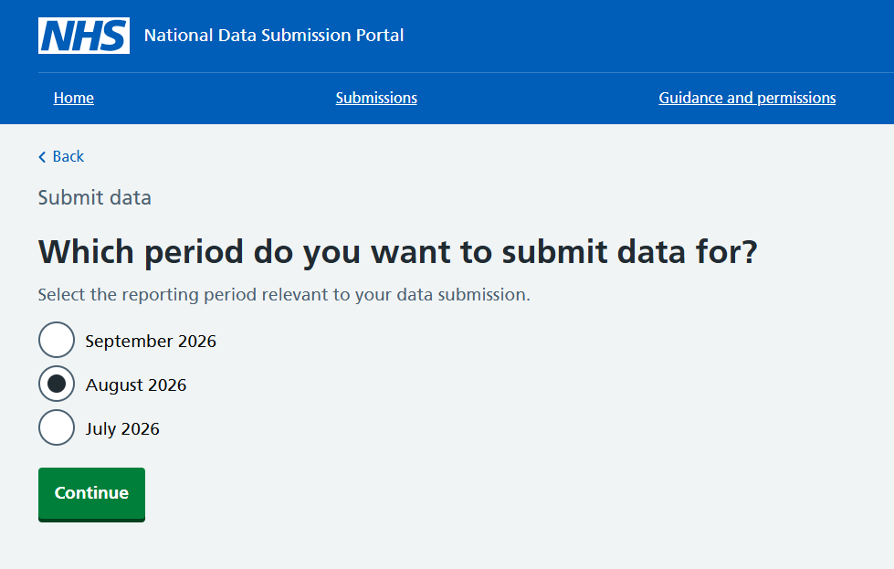
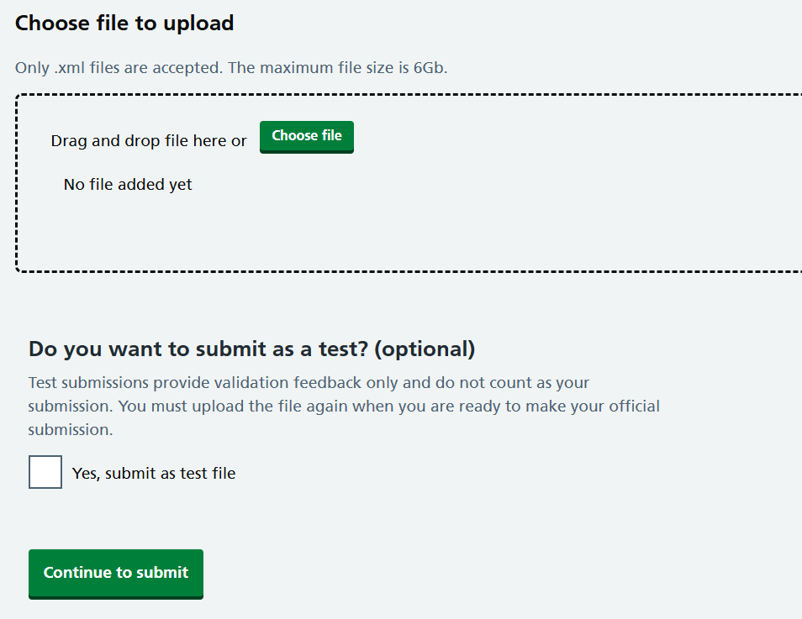
Submission information
Data submissions are required each month containing activity data for the preceding month (e.g. in the August submission window you would submit activity data for July)
If no activity occurred, there will be an option to report no activity
Providers can make a test submission
Providers can resubmit data for previous months by selecting the relevant activity month in the portal
Data can be resubmitted for the financial year, up until 31st July
Submission file format for LCS is XML

Slide 27
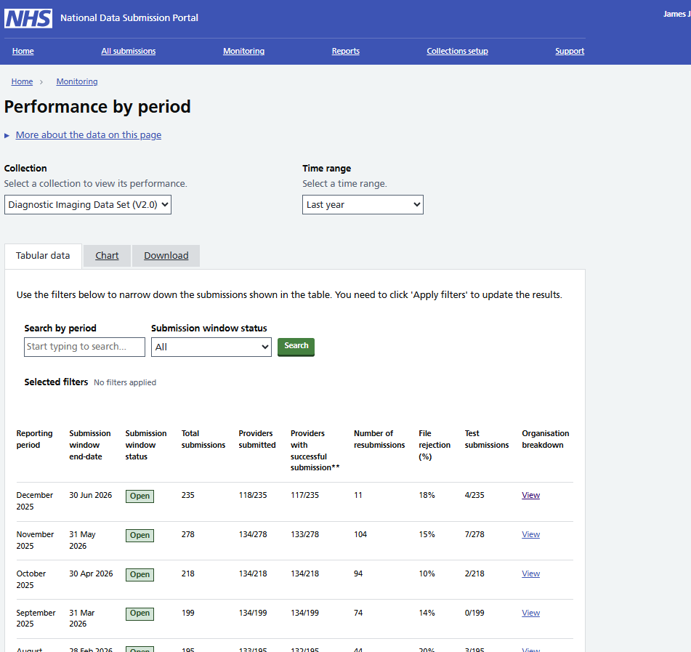
Cancer Alliance Submission Dashboard
  NDSP includes tools to support collection monitoring. We are looking at how these can meet Cancer Alliance needs.

Slide 28
NDSP: opportunities to get involved in design work
Now: usability testing with LCS data submitters, to understand more about your needs, and to get feedback on interface designs. If you’d like to participate, please contact Abhilaasha.kaul2@nhs.net for more information.
Next: workshops with Cancer Alliances to look at collection monitoring designs.

Slide 29
Supporting analytical requirements
Notes:
Demo the file submission process, submission history and viewing error reports

Slide 30
Analytical Reporting Requirements
Real Time
Providers: data quality report detailing file and record level rejections
Cancer Alliances: view on which providers have submitted, how many resubmissions, and highlight data quality information (e.g. % records rejected)
Monthly Data Quality Dashboard
(to be developed July 2026 onwards, expectation to be live from January 2027 onwards)
Ability for Cancer Alliances to sense check the data, reviewing aggregate summations for errors
E.g. any missing data for key data items, any incorrect effectiveness stands, any metrics which incorrect proportions.
Data quality, rules and assurance
National dashboard development
Data linkage
Cancer Alliance record level access

Slide 31
Analytical Reporting Requirements
Monthly Activity Dashboard
(to be developed July 2026 onwards, expectation to be live from January 2027 onwards)
Accessed by national team and Cancer Alliances
Mimicking data reporting currently shared via Cancer Alliance packs and Cancer Programme Delivery groups
Ability to filter for Cancer Alliance.
Ability to filter for provider.
Ability to download aggregate data extracts.
Won’t include cancer diagnostics or staging data.
Data quality, rules and assurance
National dashboard development
Data linkage
Cancer Alliance record level access

Slide 32
Analytical Reporting Requirements
Ability to link Lung Cancer Screening Record level data with:
NDRS cancer outcomes (rapid registration data)
Cancer Waiting Times
Diagnostic Imaging dataset
To:
- Determine the number of cancers diagnosed and staging.
Data quality, rules and assurance
National dashboard development
Data linkage
Cancer Alliance record level access

Slide 33
Analytical Reporting Requirements
Cancer Alliance Analyst requirements:
- Download aggregate data from dashboard for providers in their area for analysis
- Easily access record level data for their area demographic analysis
- Easily access linked data for their area to see lung cancers diagnoses
Data quality, rules and assurance
National dashboard development
Data linkage
Cancer Alliance record level access

Slide 34
Analytical Reporting Requirements
March 2026
July 2026
Jan 2027
April 2027
2026
2027
Governance, access and readiness
Data development and derivations
Data quality, rules and assurance
National dashboard development
Data linkage
Cancer Alliance record level access

Slide 35
Analytical Reporting Requirements Summary
Main focus for 2026/27 financial year
Complete governance, access and readiness work for providers to be able to submit record level data
Complete data model development and derivations work to pipeline the dataset into FDP for analytical and quality assurance reporting.
Define the data quality rules and assurances – develop a real time view for alliances and data quality dashboard for national team and cancer alliances to access to monitor accuracy of data submitted and work with providers to improve this.
Start development of national dashboard reporting activity data for the programme. This won’t be used as the main source of reporting for 2026/27 financial year as aggregate data will continue to be submitted and used – we also won’t have the ability to link the data as we continue to develop this work. But the hope is that we can demonstrate usability of this
Data linkage complete.
Access to record level data for cancer alliances.
Monthly dashboard replacing cancer alliance data packs.
Development of plans for data sharing with other stakeholders (outside of national colleagues and alliances)
Contact for more information or to feedback: Charlotte.Graham14@nhs.net
Main focus for 2027/28 financial year

Slide 36
Provider support

Slide 37
Data Liaison Service Supporting LCSDS Onboarding
The Data Liaison Service (DLS) is part of the Data Collection and Improvement service in NHS England.
We engage and support care providers by email, Teams and on a 1:1 basis at scale to onboard providers to new or changed data sets and improve data collected nationally.
DLS support has been prioritised to help providers navigate their onboarding journey with preparatory activities, documentation, guidance and available resources for LCSDS.
Central Team/General DLS Mailbox england.dataliaison@nhs.net
Notes:
Plain slide with subhead and bullets

Slide 38
Next steps
Share slides and recording
Readiness questionnaire
Series of drop-in sessions/ surgeries (covering a range of topics such as IG, getting set up with an API, how do I register to submit data)
Usability testing and ongoing UCD activity
Setting up new ODS LCS provider site codes
Issuing of guidance on getting NDSP permissions and CIS2 accounts
Welcome requests for smaller groups sessions

Slide 39
Q&A

Slide 40
Who to contact?
Data set related queries:
Dataset.Development@nhs.net.
Policy or general programme questions:
england.lungcancerscreening@nhs.net
Data Liaison Support:
england.dataliaison@nhs.net

